Slide 1
Easy eats capstone project
Zhengyu Duan

Slide 2
Problem to solve
Restaurant nearby
What to eat …

Slide 3
Overview

Slide 4
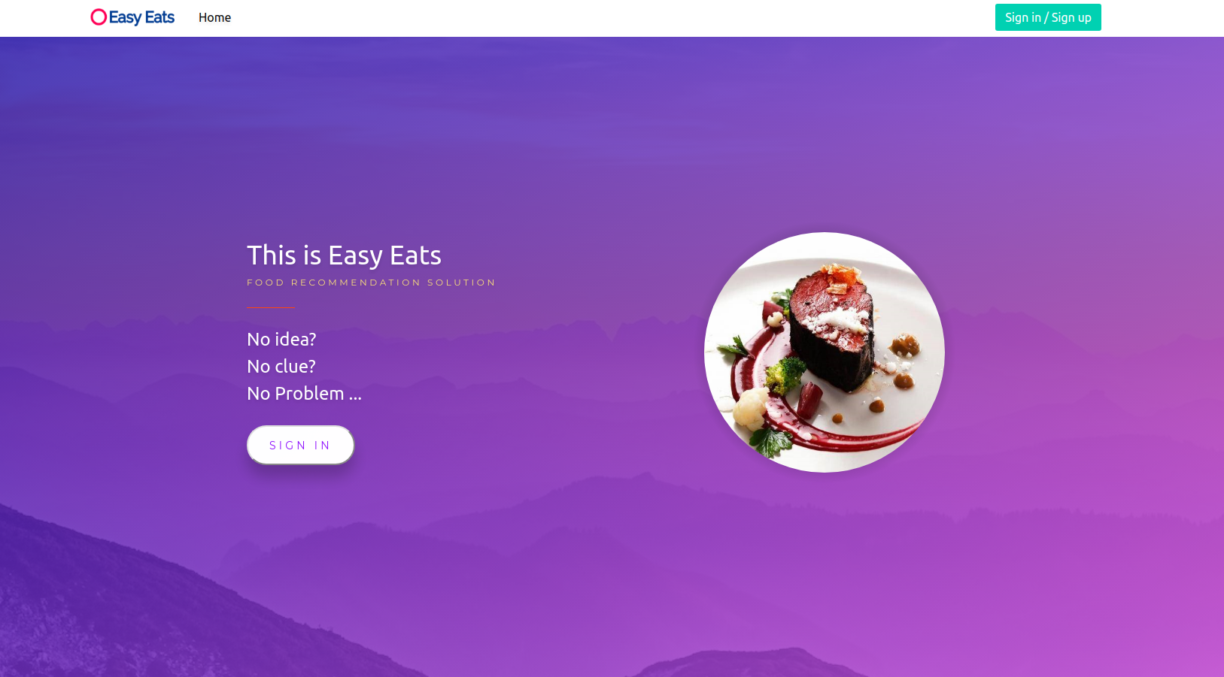
Pages - index

Slide 5
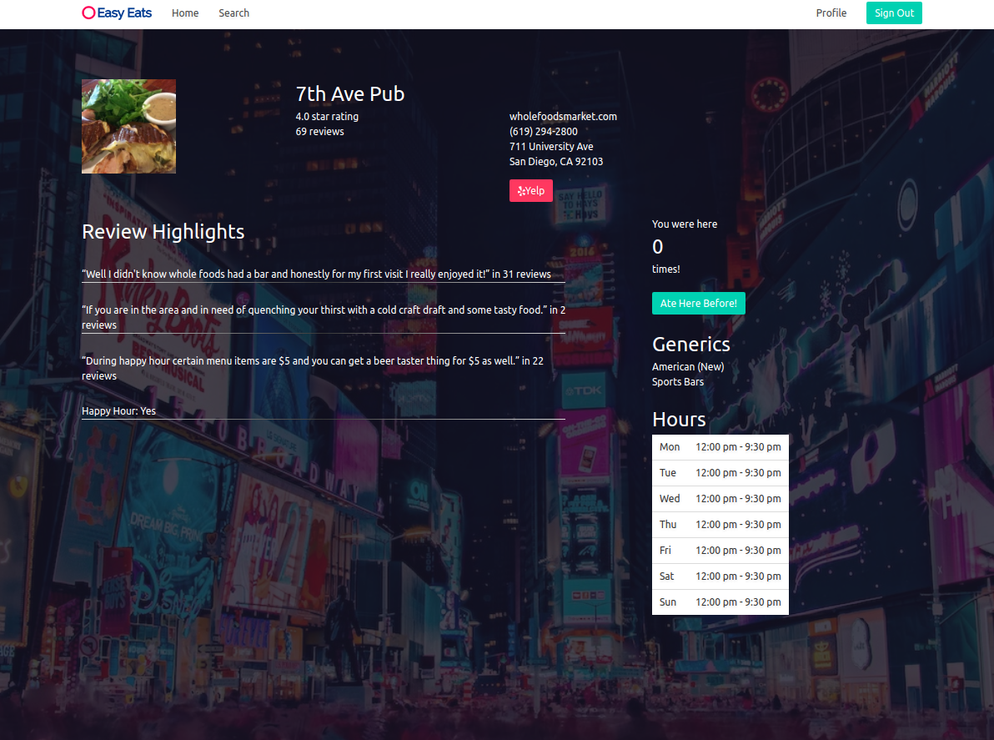
Pages – restaurant page

Slide 6
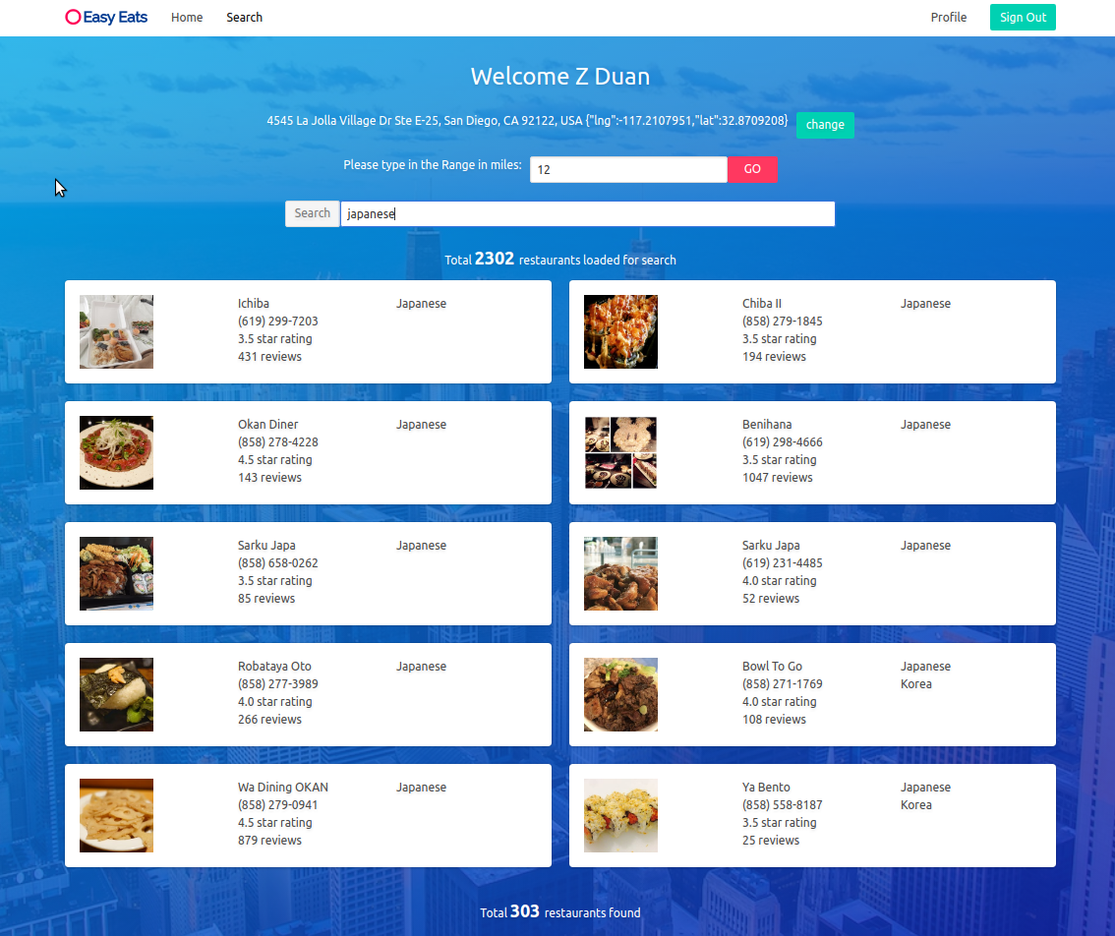
Pages - search

Slide 7
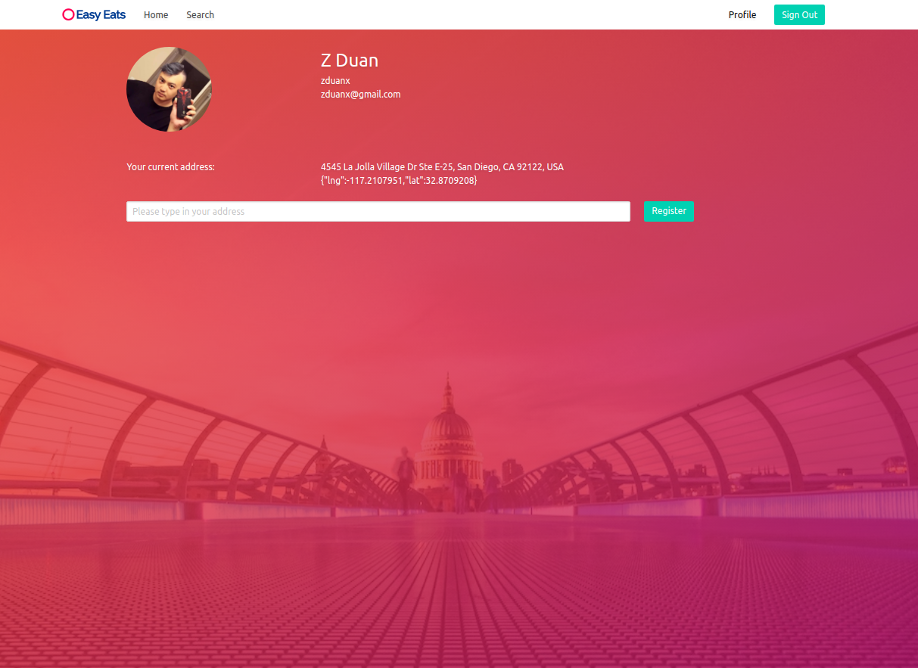
Pages - profile

Slide 8
Architecture Overview

Slide 9
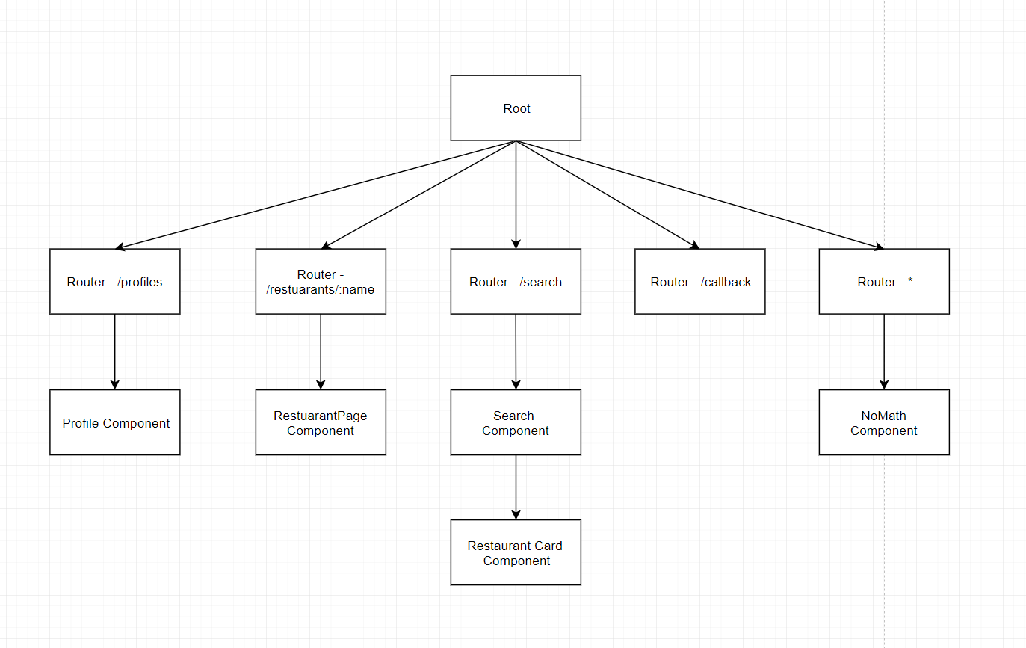
React Components

Slide 10
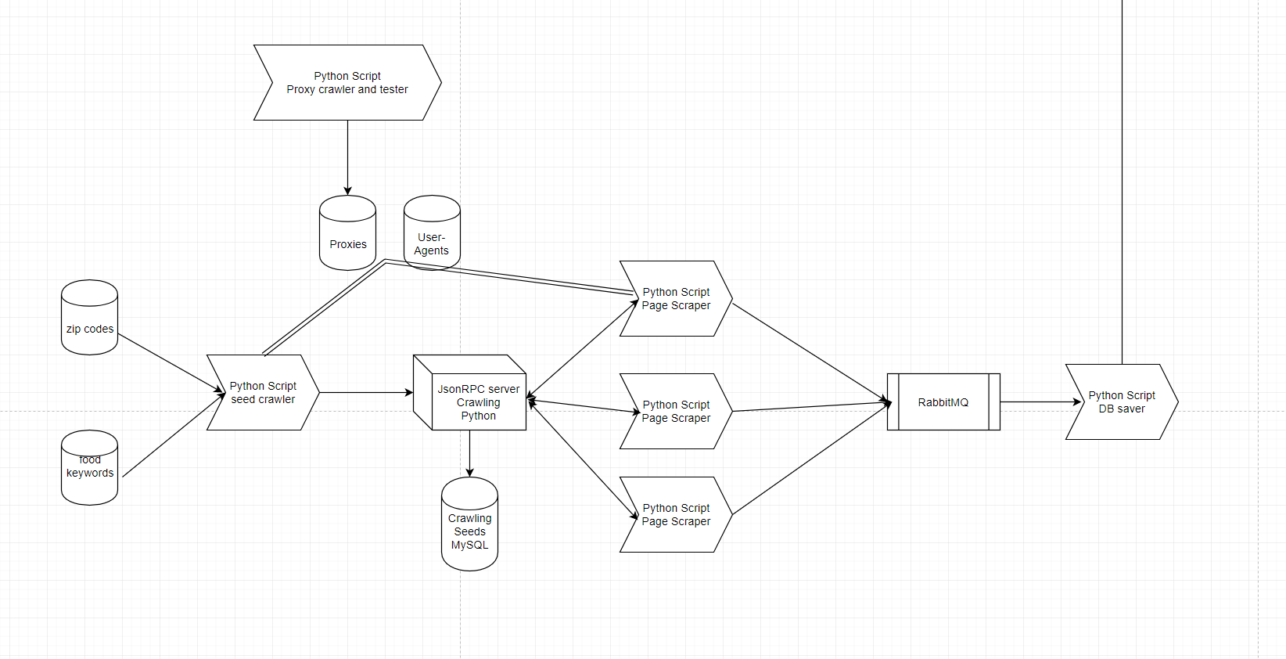
Crawling System
To MongoDB

Slide 11
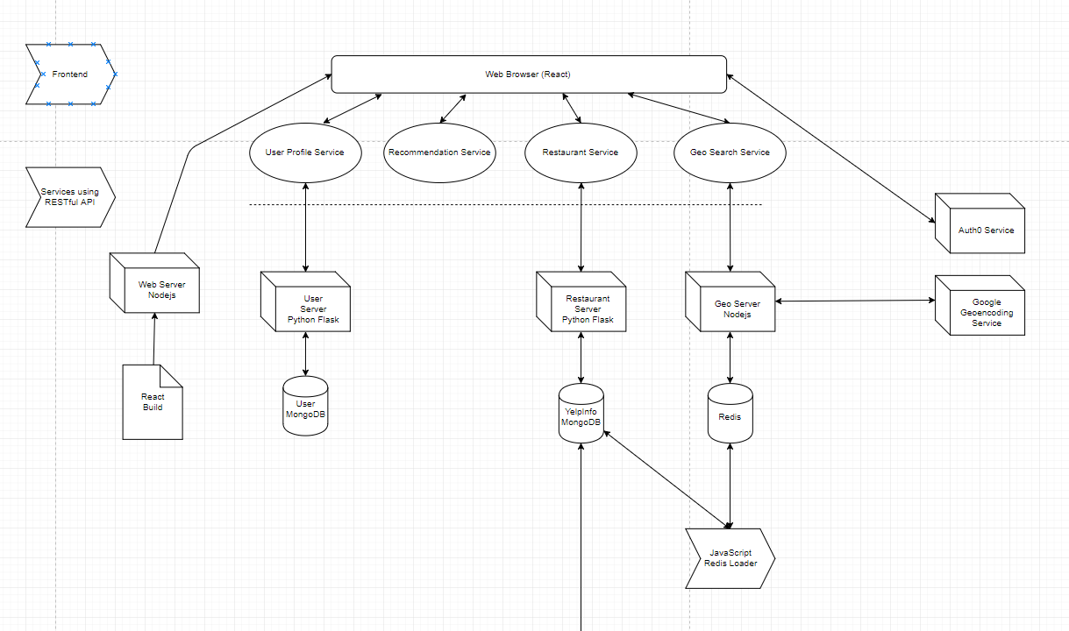
Backend Servers
From Crawling System

Slide 12
Details

Slide 13
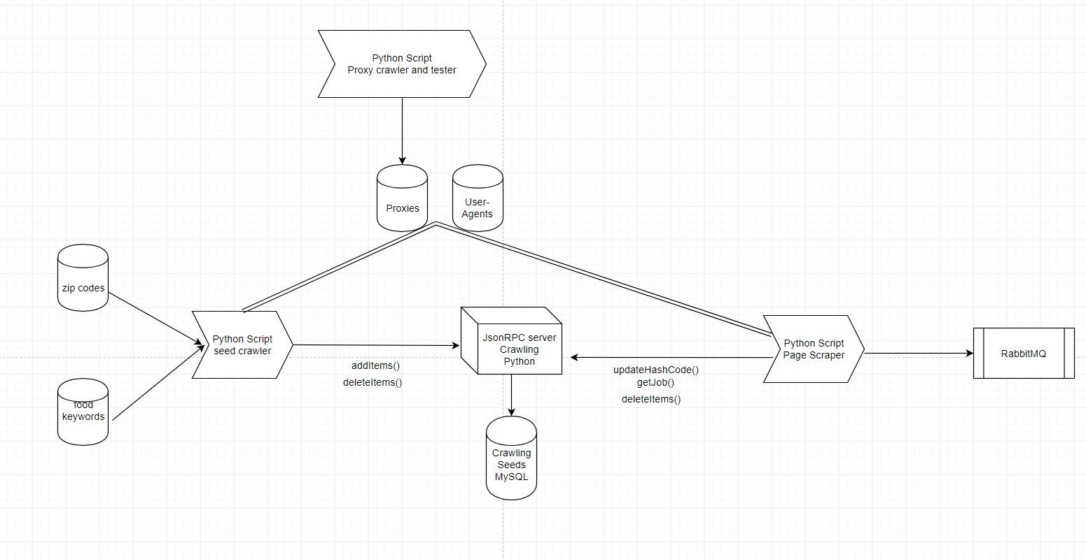
Crawling System

Slide 14
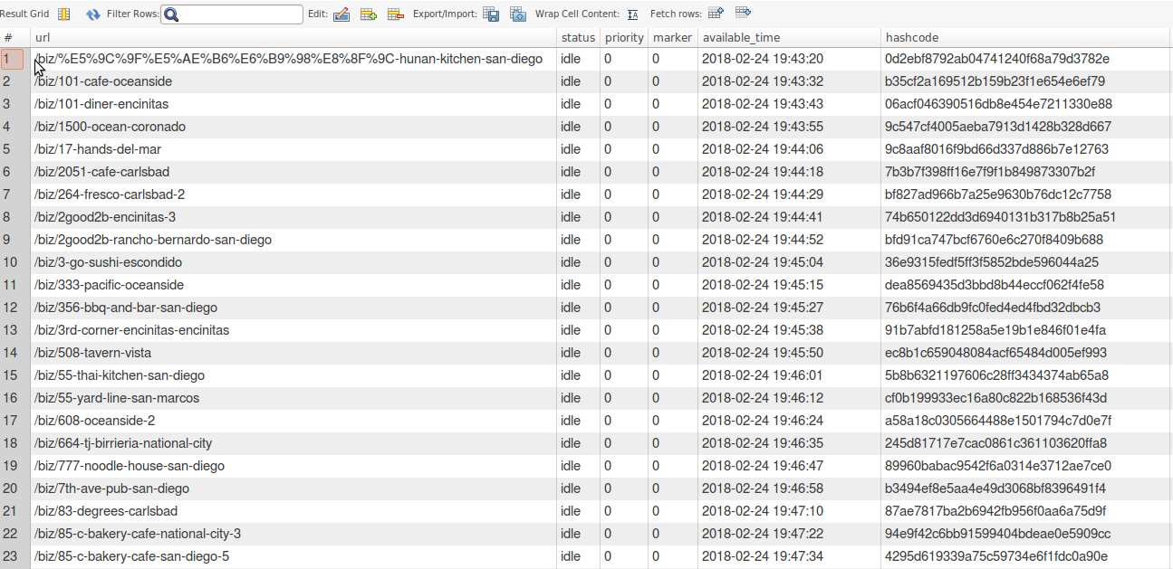
MySQL Schema

Slide 15

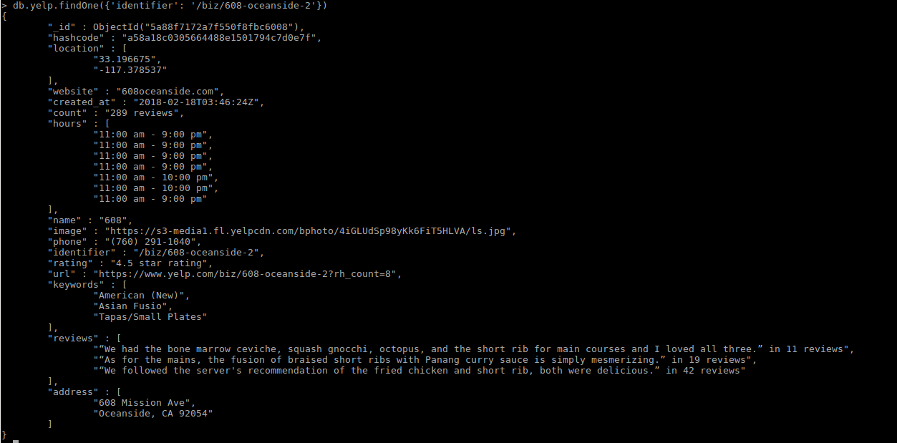
Yelp-Info Schema

Slide 16
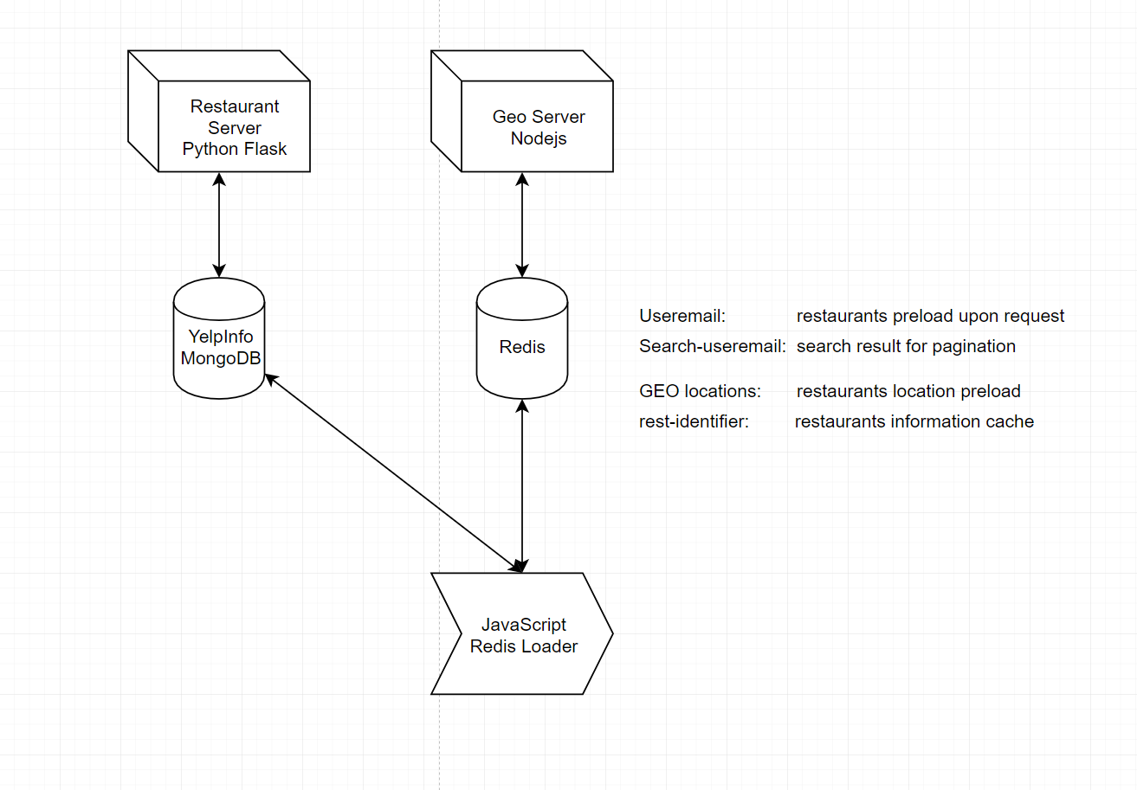
Redis-geo preload

Slide 17
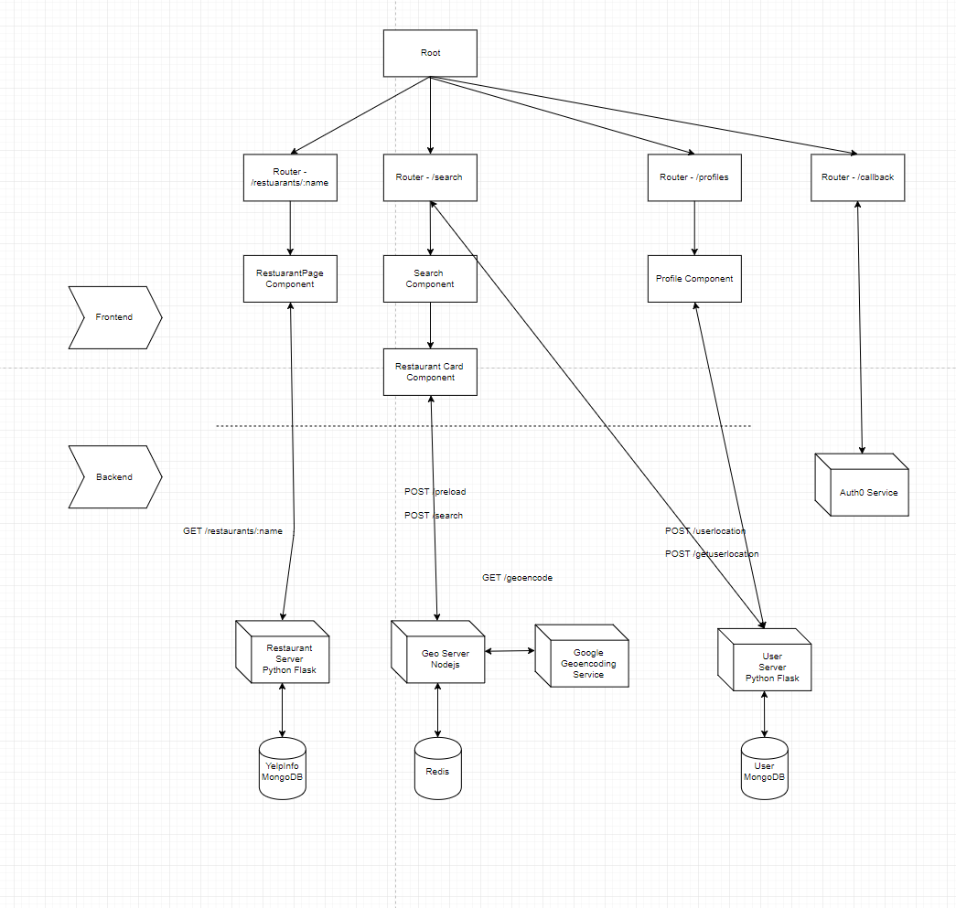
Backend services

Slide 18
Misc

Slide 19
Stacks
React
React-router-dom
Nodejs-express
RabbitMQ
Restful API
JsonRPC
Microservice Architecture
MongoDB
Redis
MySQL

Slide 20
Challenge
CSS
CORS
MySQL
Redis-geo
React
Xpath

Slide 21
Future work
User restaurant footprint
User restaurant recommendation
Pagination
Backend user authentication

Slide 22
Questions?

Slide 23
Thank you!

